Slide 1
Music/artist “Hotness”
By:

Slide 2
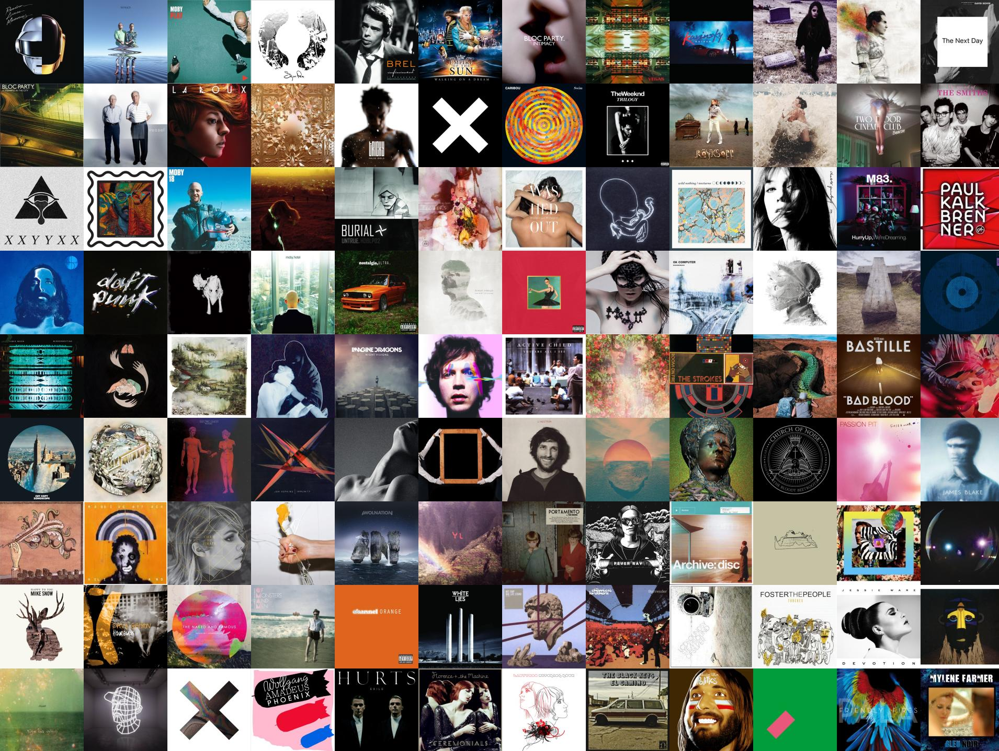

Slide 4


